Slide 1







JIBEBE:ELECTRIC VEHICLE PROJECT
Supervisors : Dr Shohei Aoki
Mr Kipkorir Rono
Mr Joseph Kimani
Mechanical Team
Alex Mburu
Emmanuel Njenga
Brian Muindi
Peter Nzioki

Slide 2
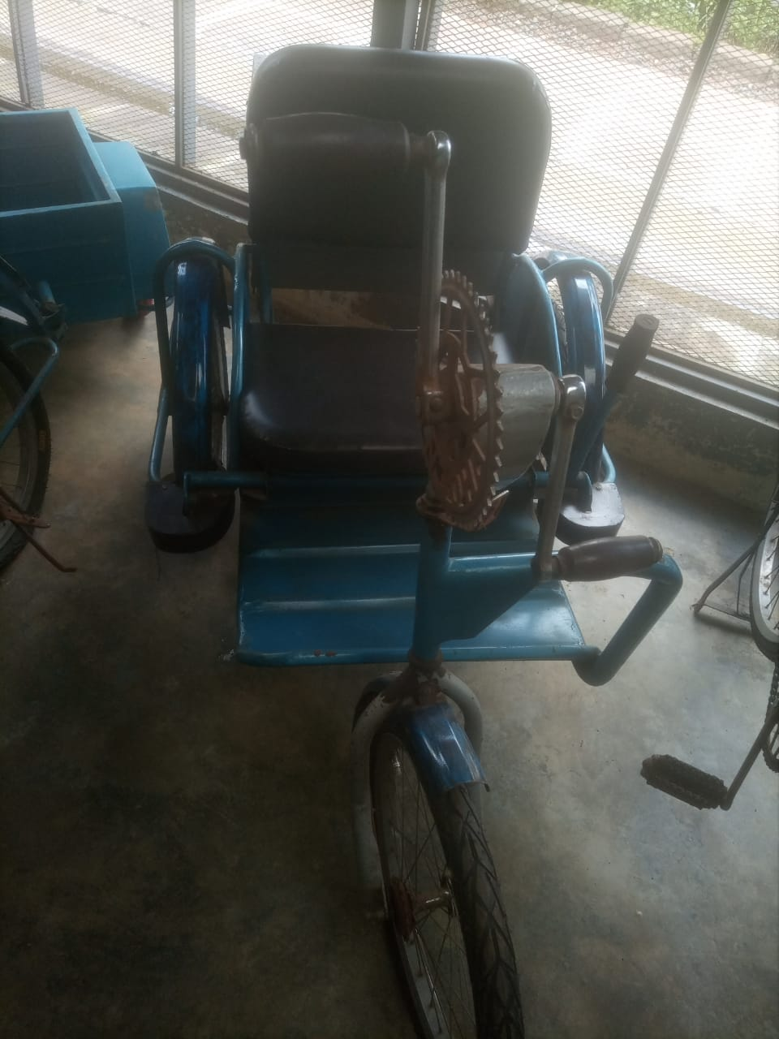
INTRODUCTION
HUMAN POWERED TRICYCLE
Specifications
Human powered tricycle
Rubber brake shoes-operated by a brake lever
Limitations
Tedious
Ineffective brake system

Slide 3
E-Tricycle
Main Objective
Design fabrication and testing of an electric tricycle
Specific objectives
Determine the power requirements for the e-tricycle
Design and fabricate the drive train
Implement mechanical disc brakes

Slide 4
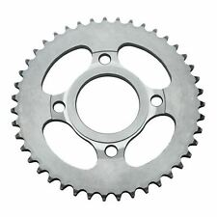
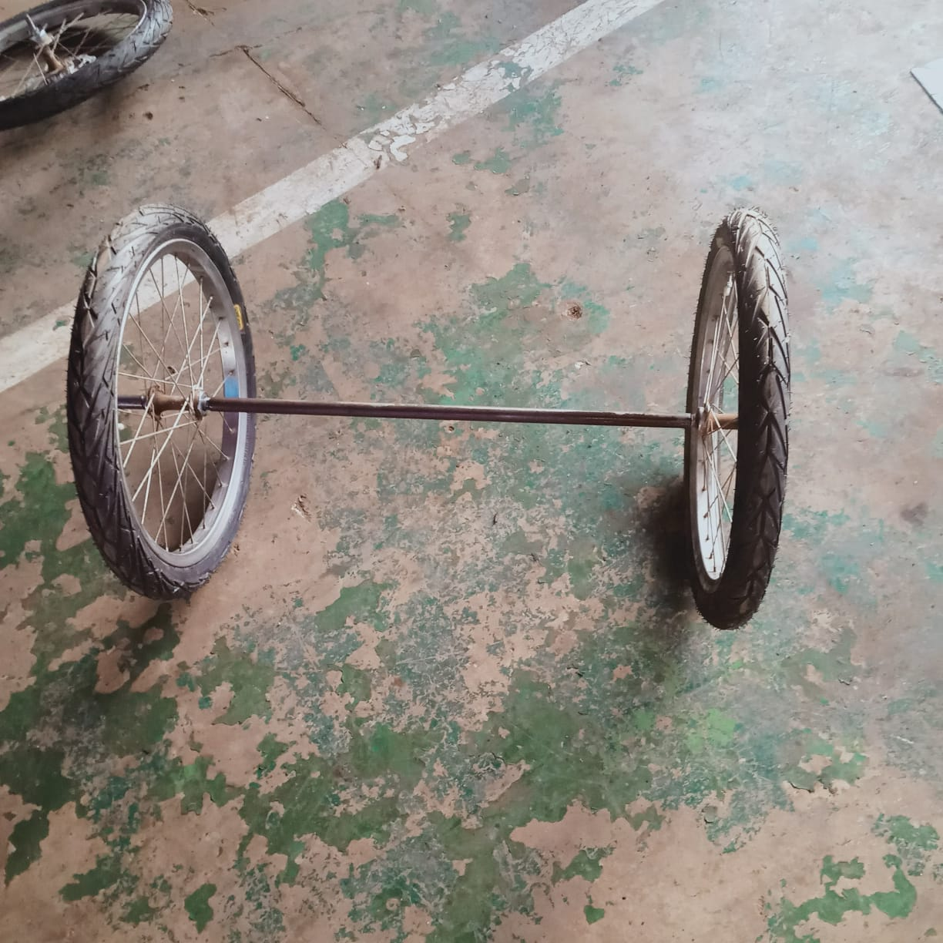
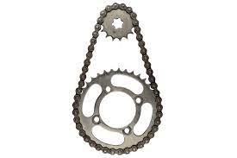
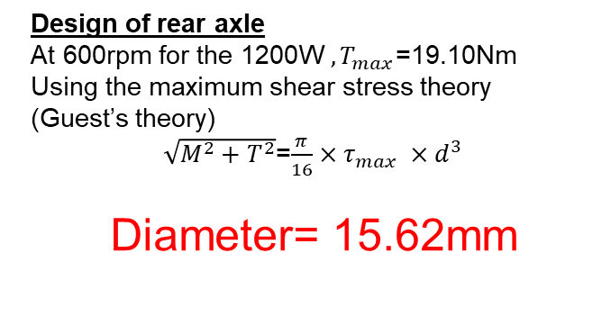

Key Content Activities
Power requirements-max speed of 16km/h-1200W-BLDC Motor
Drive train
Chain drive design
Design for the sprockets
Speed ratio=3.5
The larger sprocket=47T
Smaller sprocket = 15T
Design for the chain
D=180mm
d=70mm
Center distance ,x = 170mm
Chain length=$π\left(R+r\right)+2x+{\left(\frac{R−r}{X}\right)}^{2}$
L=760mm
Design of rear axle
At 600rpm for the 1200W ${, T}_{max}$=19.10Nm
Using the maximum shear stress theory (Guest’s theory)
$\sqrt{M^{2}+T^{2}}$=$\frac{π}{16}×τ_{max} ×d^{3}$
Diameter= 15.62mm

Slide 5
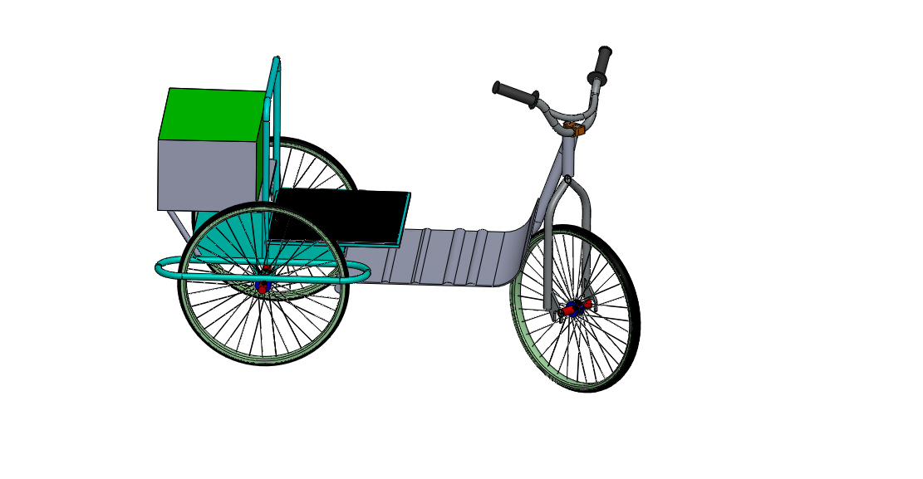
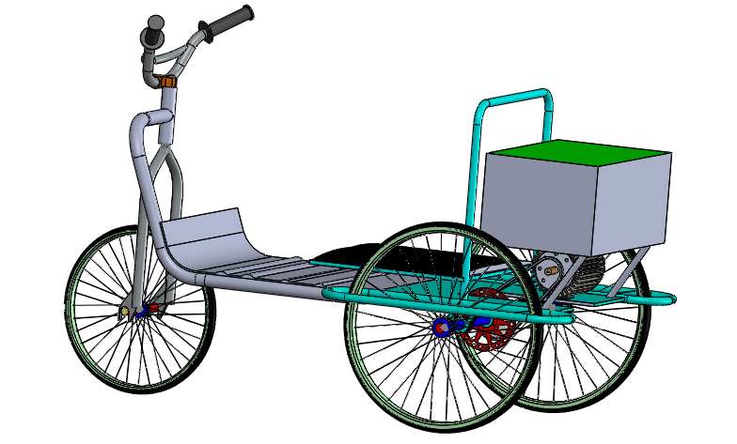
3D modeling of the tricycle
Parts redesigned
Steering
Braking mechanism
Rear wheels
Motor positioning
Motor

Slide 6
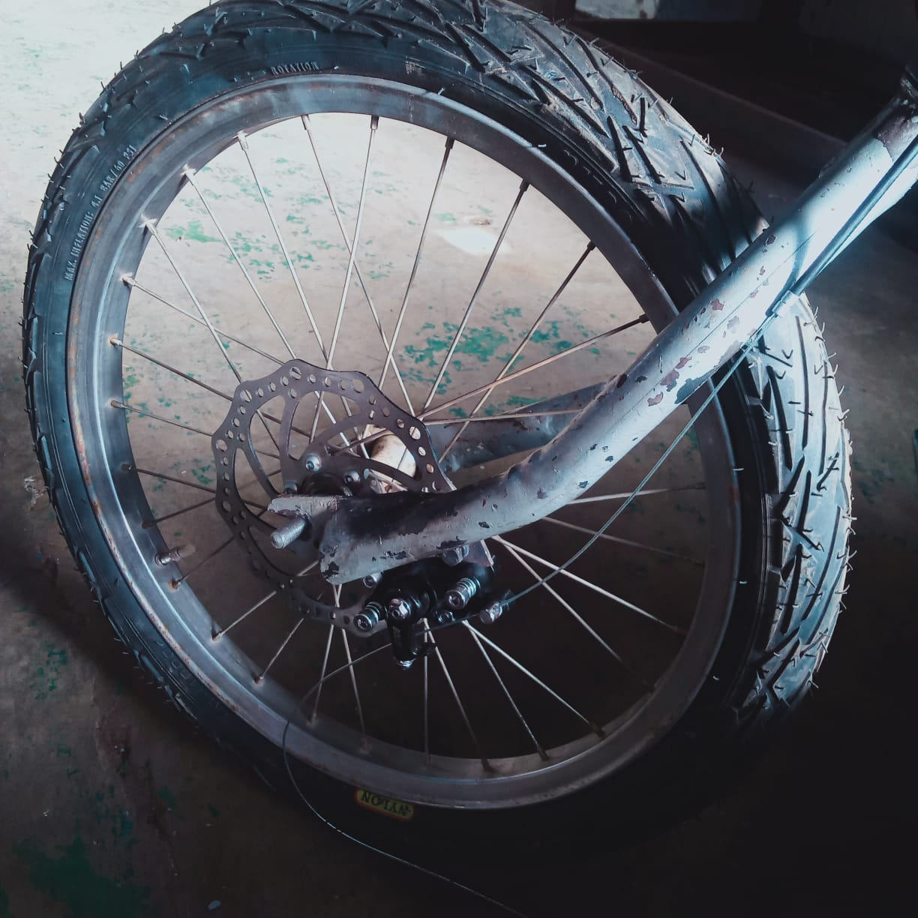
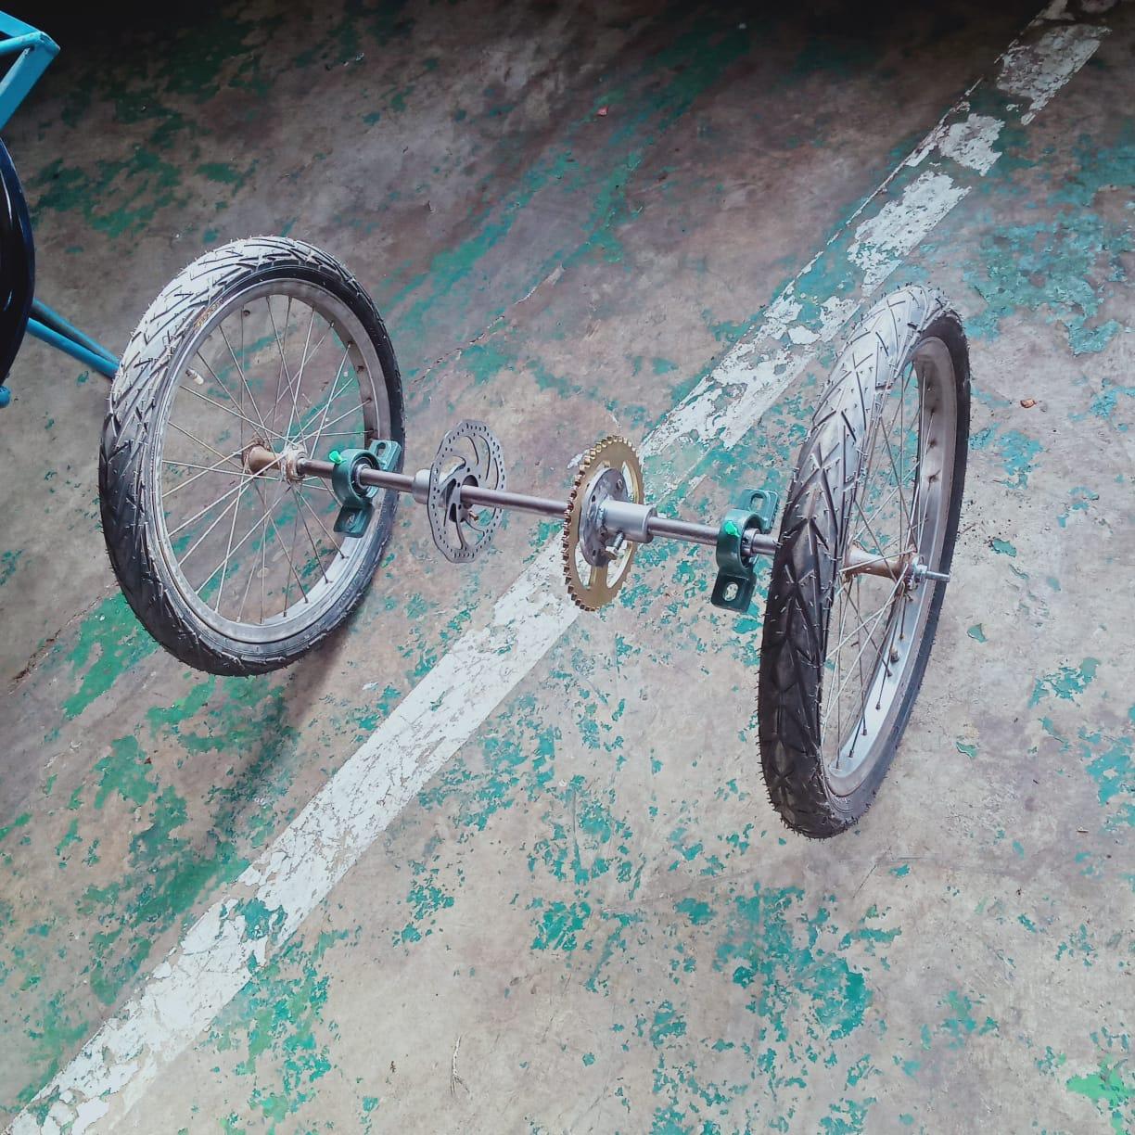
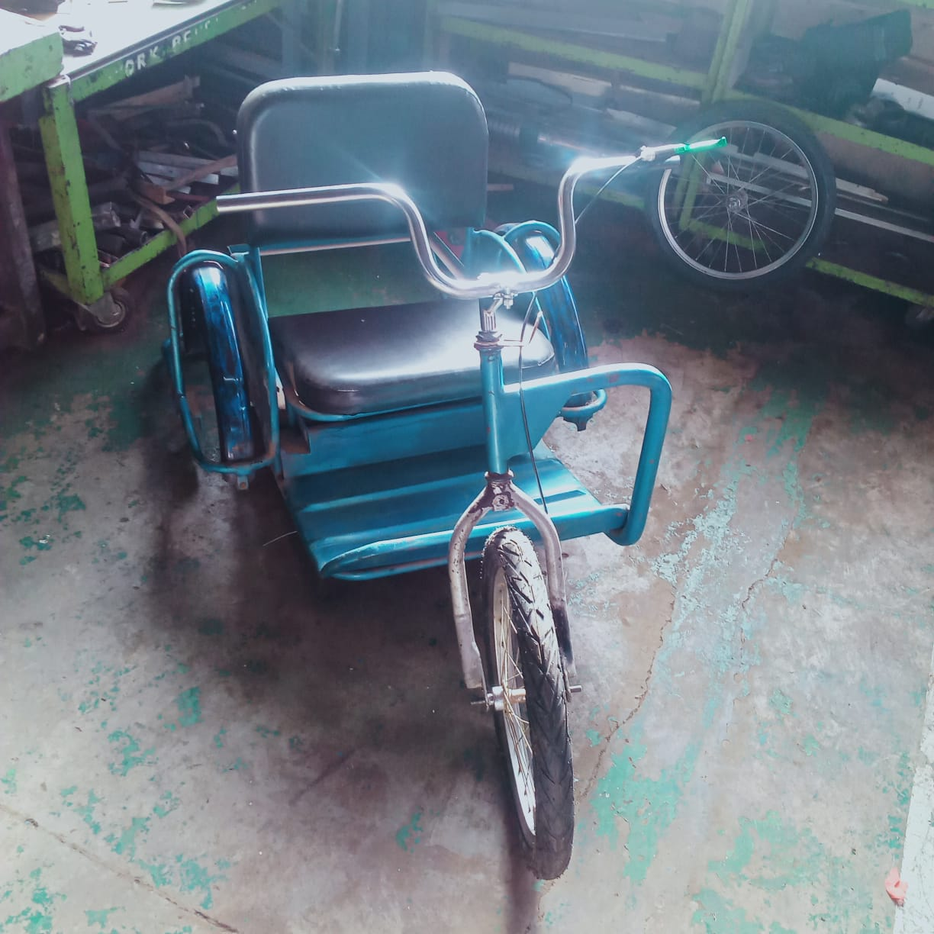
Fabrication and assembly of components
1.Steering-handle bars –
easy steering and other attachments i.e throttle,brake shifters
2.Braking mechanism
Mechanical brakes-both front and rear
Brake shifters
Brake calipers
Front Brake
rotor
Rear Brake
rotor

Slide 7
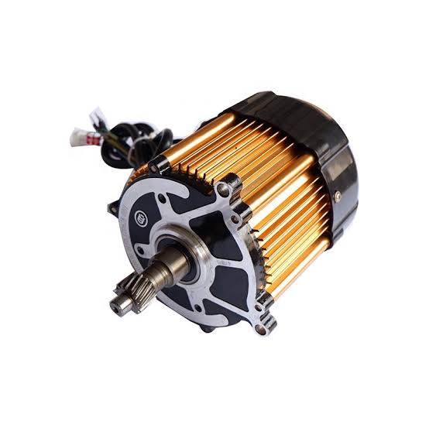
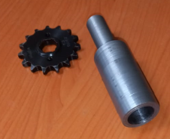
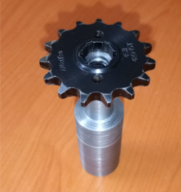
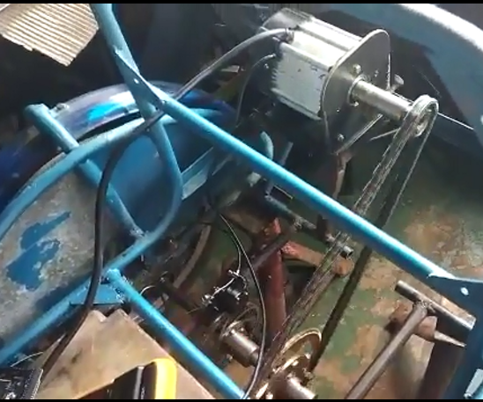
Large sprocket
Chain
Drive train
Motor
Chain
BLDC motor
Attachment on the motor
Sprocket

Slide 8
Assembly and testing of the e-tricycle

Slide 9
Recommendations
Implement a suspension system for better ride comfort
Centre alignment of the handle bars to improve steering and better handling

Slide 10
E-TRACTOR
Main Objective
Design fabrication and testing of an electric tractor
Specific objectives
Determine the power requirements for the e-shujaa tractor
Stress and vibrational analysis of the e-tractor chassis
Redesign the transmission system
Assembly and testing of the e-tractor

Slide 11
POWER REQUIREMENTS FOR THE SHUJAA E-TRACTOR
TORQUE REQUIREMENTS FOR THE SHUJAA E-TRACTOR
Case 1:Working mode
Working speed=11km/h
Torque from motor=27.28Nm
Torque required at the driving wheels=1800Nm
Case 1:Working mode
Power required when the tractor is accelerating(0-11km/h) and ploughing= 6.7923 kw
Case 2:Transport mode
Power required when the tractor is accelerating(0-30km/h) but NOT ploughing= 6.855kW
Gear ratio=47.98
Case 2:Transport mode
Working speed=30km/h
Torque from motor=27.28Nm
Torque required at the driving wheels=479.98Nm
15kW motor
Gear ratio=17.59

Slide 12
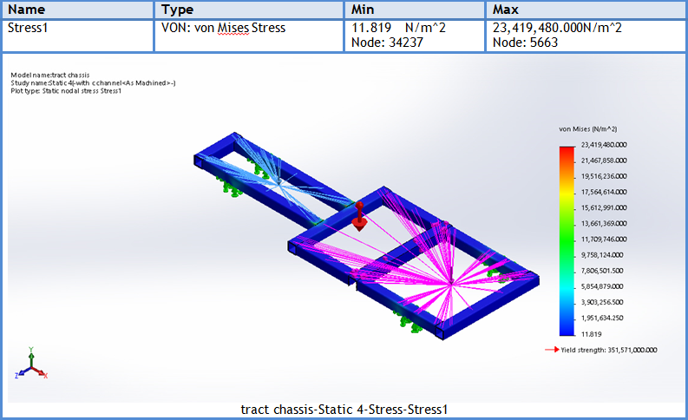
Static and vibration analysis of the tractor chassis
Static analysis
Frequency analysis
Freq No | Rad/sec | Hertz
1 | 2986.7 | 475.34
2 | 5540.9 | 881.86
3 | 11383 | 1811.7
4 | 13137 | 2090.9
5 | 13327 | 2121.1
For a top speed of 3500rpm
Operating frequency of the motor is 58.33Hz (366.52rad/s)
FOS=15

Slide 13

Thank you

